Slide 1
Comprehensive Exploratory Data Analysis (EDA) Report For
Global Electronics
Enhancing Customer Satisfaction, Optimizing Operations, and Driving Business Growth
Prepared by: ELAKKIYA.P

Slide 2
Introduction:
Overview of Global Electronics
Company Profile: Global Electronics is a prominent retailer specializing in consumer electronics with a global reach. The company aims to deliver top-notch products and exceptional customer service.
Mission: To provide high-quality electronics and innovative solutions, enhancing customer experiences through advanced technology.
Market Presence: Global Electronics operates through a vast network of physical stores and online platforms, serving a diverse international customer base.
Objective of the Analysis
Primary Goal: Conduct a thorough Exploratory Data Analysis (EDA) to derive actionable insights from the company's datasets.
Key Objectives:
Enhance marketing strategies by analyzing customer behavior and demographics.
Optimize inventory management based on product performance and sales data.
Improve sales forecasting with historical data and trend analysis.
Inform product development and store expansion decisions using detailed performance metrics.

Slide 3
Scope of Data:
Datasets Included:
Stores Data: Information on store locations and operational details.
Products Data: Details about products and their categories.
Sales Data: Transaction records and sales information.
Exchange Rates Data: Impact of currency fluctuations on international sales.
Customers Data: Customer demographics and details.
Data Coverage: The analysis includes comprehensive data from multiple regions, product categories, and time periods to provide a detailed understanding of business operations and customer interactions.

Slide 4
Data Cleaning Steps:
Handling Missing Values:
Identification: Check for missing or null values across all datasets.
Approach:
Imputation: Fill missing values with appropriate substitutes (e.g., mean, median, mode) or use interpolation for continuous variables.
Removal: Exclude rows or columns with excessive missing values if imputation is not feasible.
Consistency: Ensure that missing values are handled consistently across related datasets.
Data Type Conversion:
Date Fields: Convert date fields to a standardized datetime format for consistency (e.g., Order Date, Open Date, Date in exchange rates).
Numerical Fields: Ensure that numerical values (e.g., Unit Cost USD, Unit Price USD, Exchange) are in the correct numeric format for calculations.
Categorical Fields: Convert categorical variables (e.g., Country, Brand, Currency Code) to consistent text or categorical types

Slide 5
Analysis and Insights :
Customer Analysis :
Demographic Distribution: Analysed customer demographics by gender, age, and location.
Purchase Patterns: Identified average order value, frequency of purchases, and preferred products.
Customer Segmentation: Segmented customers based on demographics and purchasing behaviour to identify key customer groups.
Sales Analysis :
Overall Sales Performance: Analysed total sales over time to identify trends and seasonality.
Sales by Product: Evaluated top-performing products in terms of quantity sold and revenue generated.
Sales by Store: Assessed the performance of different stores based on sales data.
Sales by Currency: Examined the impact of different currencies on sales, considering exchange rates.

Slide 6
Product Analysis :
Product Popularity: Identified the most and least popular products based on sales data.
Profitability Analysis: Calculated profit margins for products by comparing unit cost and unit price.
Category Analysis: Analyzed sales performance across different product categories and subcategories.
Store Analysis :
Store Performance: Evaluated store performance based on sales, size, and operational data.
Geographical Analysis: Analyzed sales by store location to identify high-performing regions.

Slide 7
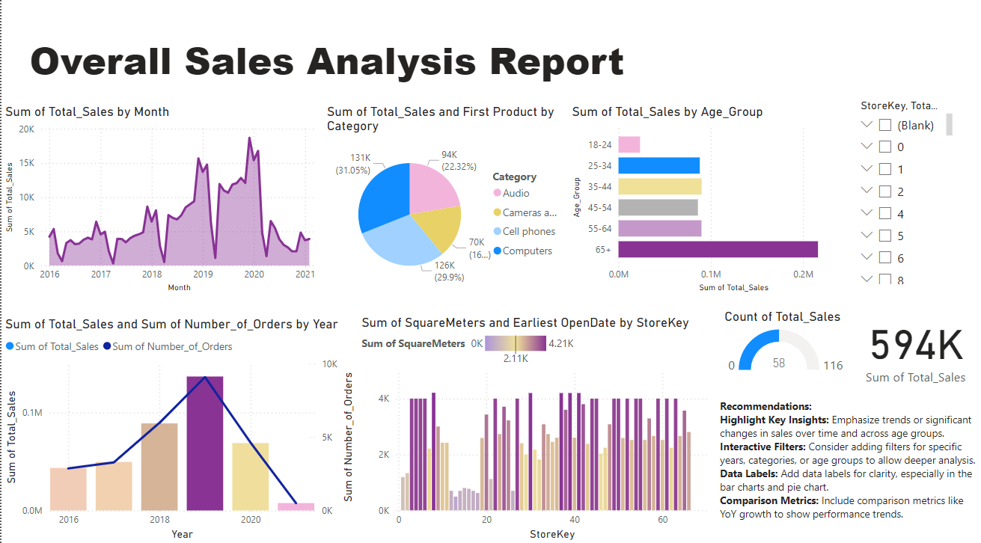

Slide 8
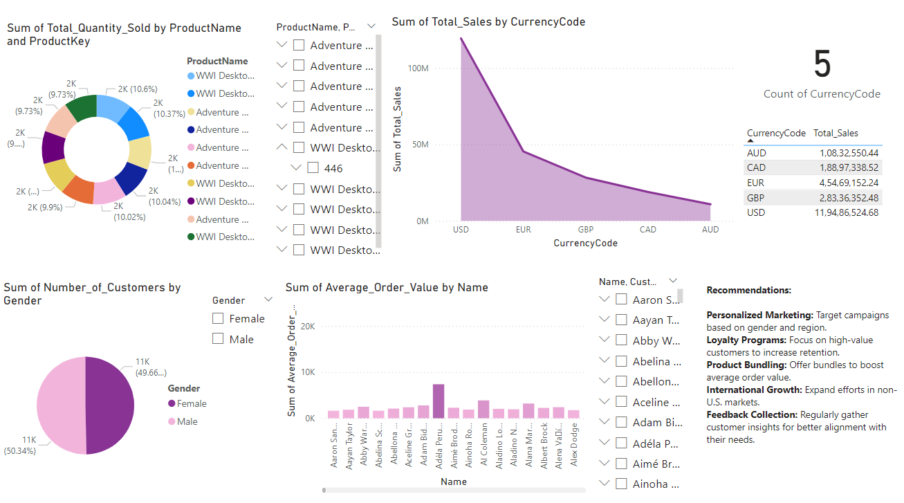

Slide 9
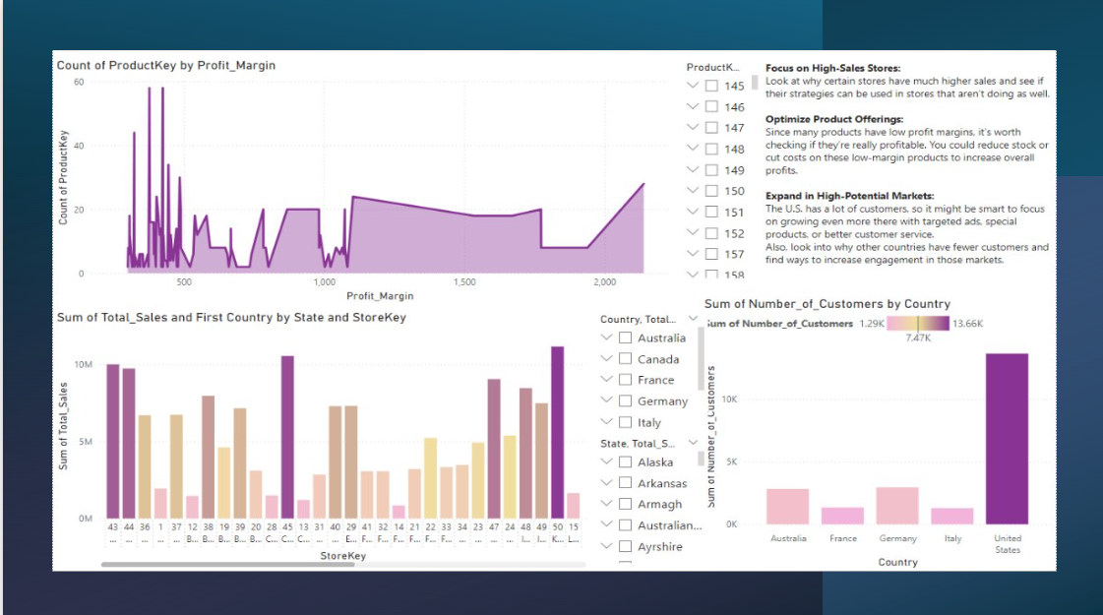

Slide 10
Insights for the Overall Sales Analysis Report:
1.Sum of Total Sales by Month :
Trend Observation: There is a noticeable fluctuation in sales over the years, with peaks around 2019 and a decline towards 2021.
Actionable Insight: Investigate the reasons behind the peaks and declines, such as marketing campaigns, product launches, or external factors, to replicate success or mitigate downturns.
2.Sum of Total Sales and First Product by Category:
Category Distribution: Computers (31.05%) and Cameras (29.9%) are the leading categories, while Audios(16.7%) have the least sales.
Actionable Insight: Focus on promoting and expanding offerings in high-performing categories, while exploring strategies to boost sales in weaker categories.
3.Sum of Total Sales by Age Group:
Demographic Insight: The 65+ age group is the largest contributor to total sales, indicating a strong market segment.
Actionable Insight: Tailor marketing strategies and product offerings to appeal more to this age group, while also finding ways to engage younger demographics.

Slide 11
4.Sum of Total Sales and Number of Orders by Year:
Sales vs. Orders: Both sales and orders peaked in 2019, followed by a significant decline.
Actionable Insight: Analyze factors that contributed to the peak year and explore ways to sustain such performance. Additionally, examine the cause of the decline to prevent future occurrences.
5.Sum of Square Meters and Earliest Open Date by StoreKey:
Store Performance: Variations in sales across different store locations.
Actionable Insight: Identify characteristics of high-performing stores to replicate success in underperforming locations. Consider factors like store size, location demographics, and opening dates.
6.Sum of Total Quantity Sold by Product Name and Product Key:
This donut chart shows a fairly even distribution among different products, each contributing around 9% to 10.7% of total sales.
The largest segment is slightly above 10%, suggesting no single product dominates sales.

Slide 12
7.Sum of Total Sales by Currency Code:
The majority of sales are in USD, indicating a strong presence in the U.S. market.
Sales in other currencies like EUR, GBP, CAD, and AUD are significantly lower, suggesting potential for growth in international markets.
8.Sum of Number of Customers by Gender:
The customer base is almost evenly split between male and female, with a slight majority of males (50.34%).
This balance suggests that marketing strategies should be gender-neutral or equally targeted.
9.Sum of Number of Customers by Country:
The United States has the highest number of customers, far surpassing other countries like Australia, France, Germany, and Italy.
This indicates a strong customer concentration in the U.S., with opportunities for expansion in other regions.
10.Sum of Average Order Value by Name:
The bar chart shows variation in average order value among different customers.
A few customers have higher average order values, suggesting the potential to focus on high-value customers for loyalty programs or special offers.

Slide 13
11. Product Key by Profit Margin:
The count of Product Keys is highest at lower profit margins, with a noticeable decline as the profit margin increases.
There is a clear pattern showing that fewer products are associated with higher profit margins, and a sharp increase in count is visible at specific intervals, suggesting certain products or product groups dominate at lower margins.
12.Total Sales by State and Store Key:
Store Keys like 28, 45, and 50 stand out with significantly higher total sales compared to others.
The data indicates that these specific Store Keys are major contributors to overall sales, which could be due to their location, product offerings, or customer base.

Slide 14
Comprehensive Business Analysis:
Seasonal Promotions: Given the seasonal trends, targeted promotions during peak sales months can further capitalize on consumer buying patterns.
Category-Specific Strategies: Focus on maintaining the dominance of Computers and cameras while boosting sales in the Cell Phones and Cameras categories through strategic promotions or new product launches.
Demographic Targeting: Tailor marketing campaigns to the 65+ age group, as they represent the largest sales segment. Also, consider strategies to engage younger age groups, particularly 25-34.
Store Optimization: Analyze the performance of stores based on their size and age to inform decisions on store expansions, closures, or renovations.
Product Optimization: Continue focusing on top-performing products like the "WWI Desktop PC" series. Consider expanding this product line or creating complementary offerings to increase sales.

Slide 15
Market Expansion: Given the strong performance in the U.S., consider strategies to expand the customer base in other countries, possibly through localized marketing efforts or partnerships.
Customer Retention: With a nearly even gender distribution, tailor marketing campaigns to specific interests of both male and female customers to boost engagement and sales.
Target High-Value Customers: Develop targeted marketing strategies for customers with higher average order values to increase repeat purchases and customer loyalty.

Slide 16
Actionable Recommendations:
1. Market Expansion
Target International Markets:
Action: Conduct market research in Australia, France, Germany, and Italy to identify specific customer needs and preferences. Develop localized marketing campaigns tailored to these regions.
Timeline: Start within the next 3 months and roll out campaigns within 6 months.
KPI: Increase in customer numbers and sales from these regions by 15% within the next year.
Localized Content and Offers:
Action: Translate the website, marketing materials, and customer support resources into the languages of these target markets. Offer localized promotions or discounts to attract new customers.
Timeline: Implement within 4-6 months.
KPI: Conversion rate from international traffic increases by 20%.

Slide 17
2. Customer Segmentation and Personalization:
Identify High-Value Customers:
Action: Analyze data to identify characteristics and behaviors of customers with the highest average order values. Segment these customers for targeted marketing.
Timeline: Complete analysis within 2 months.
KPI: Customer Lifetime Value (CLV) of high-value segments increases by 10% over the next year.
Personalized Marketing Campaigns:
Action: Develop personalized email campaigns, offers, and product recommendations for high-value customers based on their purchasing history and preferences.
Timeline: Launch personalized campaigns within 3 months.
KPI: Open and click-through rates for these campaigns exceed 25% and 10%, respectively.

Slide 18
3. Product Development and Bundling
Expand Best-Selling Product Lines:
Action: Introduce new models or versions of the top-selling "WWI Desktop PCs" and offer bundles with related accessories (e.g., monitors, keyboards, software).
Timeline: Develop and launch new products and bundles within 6-9 months.
KPI: Sales of these new products or bundles achieve 15% of total sales within the first year.
Cross-Selling and Upselling:
Action: Implement cross-selling and upselling strategies on the e-commerce platform, suggesting complementary products at checkout.
Timeline: Implement within 3 months.
KPI: Average order value increases by 10%.

Slide 19
4. Revenue Stabilization
Seasonality and Promotional Calendar:
Action: Analyze sales data to identify seasonal patterns and create a promotional calendar to boost sales during traditionally slower periods.
Timeline: Analysis and calendar development within 2 months, promotions implemented year-round.
KPI: Reduce sales volatility by 20% year-over-year.
Dynamic Pricing Strategy:
Action: Develop a dynamic pricing model that adjusts prices based on demand, market conditions, and competitive pricing.
Timeline: Pilot the pricing model within 4-6 months.
KPI: Improve profit margins by 5% without negatively impacting sales volume.

Slide 20
5. Customer Loyalty and Retention
Loyalty Program Launch:
Action: Design and implement a loyalty program that rewards repeat customers with points, discounts, or exclusive offers.
Timeline: Launch within 4 months.
KPI: Increase customer retention rate by 15% and average purchase frequency by 10%.
Exclusive High-Value Customer Perks:
Action: Offer exclusive perks to high-value customers, such as early access to new products, dedicated customer support, or special discounts.
Timeline: Roll out within 3 months.
KPI: High-value customer satisfaction scores increase by 20%.

Slide 21
6. Data and Performance Monitoring
Regular Sales and Market Analysis:
Action: Implement a monthly review process for sales data, customer feedback, and market conditions to adjust strategies as needed.
Timeline: Ongoing, starting immediately.
KPI: Quarterly reviews show progress in key metrics like sales growth, customer acquisition, and retention.
Automate Reporting and Insights:
Action: Set up automated reporting tools in Power BI or similar platforms to track KPIs and generate actionable insights.
Timeline: Complete within 2 months.
KPI: Decision-making process is streamlined, with actionable insights available in real-time.

Slide 22
Future Enhancement Strategies:
1. Diversify Product Offerings
New Products: Expand beyond desktop PCs to include laptops, tablets, and smart devices.
Eco-Friendly Products: Introduce sustainable, energy-efficient products.
Timeline: Market research in 6 months, new products in 12-18 months.
2. Improve Customer Experience
Personalization: Use AI to offer tailored product suggestions and personalized marketing.
VR/AR Shopping: Introduce virtual and augmented reality for an immersive shopping experience.
Timeline: Start AI in 6-12 months, VR/AR in 2-3 years.
3. Expand Globally
Localization: Adapt websites and marketing for emerging markets.
Partnerships: Collaborate with local companies for faster market entry.
Timeline: Start localization in 12 months, partnerships in 18-24 months.

Slide 23
4. Use Advanced Analytics
Predict Inventory Needs: Use data to predict demand and manage inventory better.
Analyze Customer Behavior: Understand customer preferences to improve marketing and product offerings.
Timeline: Develop models in 12 months, ongoing customer analysis.
5. Embrace Digital Innovation
Blockchain: Use blockchain for transparent and ethical supply chains.
Omnichannel Shopping: Connect online, mobile, and in-store shopping for a seamless experience.
Timeline: Pilot blockchain in 18-24 months, omnichannel in 12 months.
6. Focus on Sustainability and CSR
Carbon Neutrality: Commit to reducing carbon emissions and invest in renewable energy.
Community Engagement: Expand corporate social responsibility programs to benefit communities.
Timeline: Start sustainability initiatives within 12 months, CSR programs in 6 months.

Slide 24
Areas for Improvement:
Product Variety
Current: Limited to a few key products, mostly desktop PCs.
Improve: Expand to more electronics like laptops, tablets, and smart devices.
Benefit: Reduces risk and attracts a wider customer base.
Customer Targeting
Current: Imbalances in demographics, mostly U.S. customers.
Improve: Target underrepresented groups and regions with personalized marketing.
Benefit: Boosts sales and customer satisfaction in new segments.
Sales Optimization
Current: Average order value varies widely.
Improve: Use upselling, bundles, and loyalty programs to increase order value.
Benefit: Increases profitability without needing more customers

Slide 25
4.Demand Forecasting
Current: Sales fluctuate due to seasonality.
Improve: Use predictive analytics to manage inventory and marketing better.
Benefit: Prevents stockouts, reduces excess inventory, and aligns marketing with demand.
5.Customer Retention
Current: Sales variability suggests weak retention.
Improve: Create loyalty programs and gather customer feedback for improvements.
Benefit: Higher customer retention leads to more stable revenue.
6.Market Expansion
Current: Sales mostly in the U.S.
Improve: Expand into emerging markets with localized strategies.
Benefit: Diversifies revenue and reduces dependency on one market.

Slide 26
7.Digital Marketing
Current: Limited insight into online presence.
Improve: Invest in SEO, social media, and better website UX.
Benefit: Attracts new customers, boosts conversions, and builds brand recognition.
8.Sustainability
Current: Little focus on sustainability.
Improve: Offer eco-friendly products and ensure ethical sourcing.
Benefit: Appeals to environmentally-conscious customers and strengthens brand reputation.

Slide 27
Conclusion:
The business has strong foundations but relies heavily on a limited range of products and a concentrated market.
To sustain growth and remain competitive, the company should diversify its product offerings, expand into new markets, and enhance its customer experience through advanced technologies and personalized marketing.
Additionally, improving customer retention, optimizing sales strategies, and adopting sustainability practices will not only drive profitability but also strengthen brand loyalty and reputation.
By addressing these areas for improvement, the company can unlock new opportunities for growth and ensure long-term success in a rapidly evolving market.

